Slide 1
Predicting The Road Accident Fatility Likelihood
Venkatesh Subramaniam

Slide 2
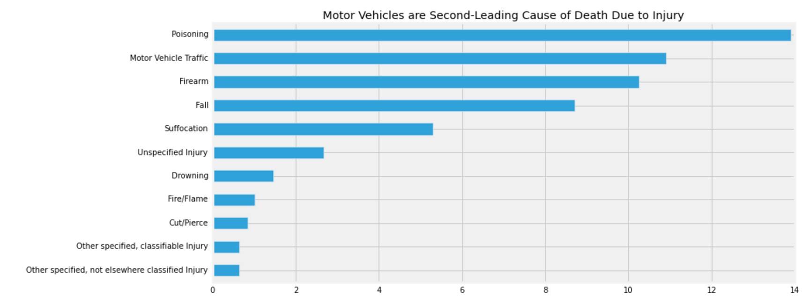
Why This Project:
Motor Vehicles Are Second-Leading Cause of Death Due to Injury
15000 collision related to road accident in a year

Slide 3
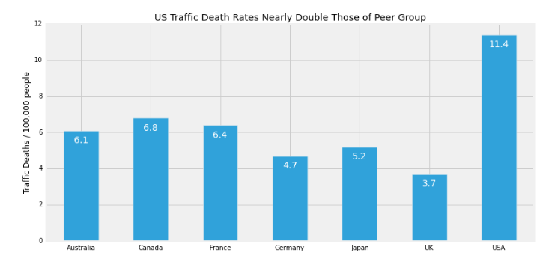

Slide 4
Project Objective:
Find the factors affecting the road accident fatality in Seattle and Boston
Build a model to predict the road accident based on climate and other important variables

Slide 5
Vizualizing Project Summary - Seattle
WundergoundHistorical Weather Data
Exploratory Data Analysis and Data Transformation
Scrape Modules
Socrata 911 Response Data
Model Building and Summary

Slide 6
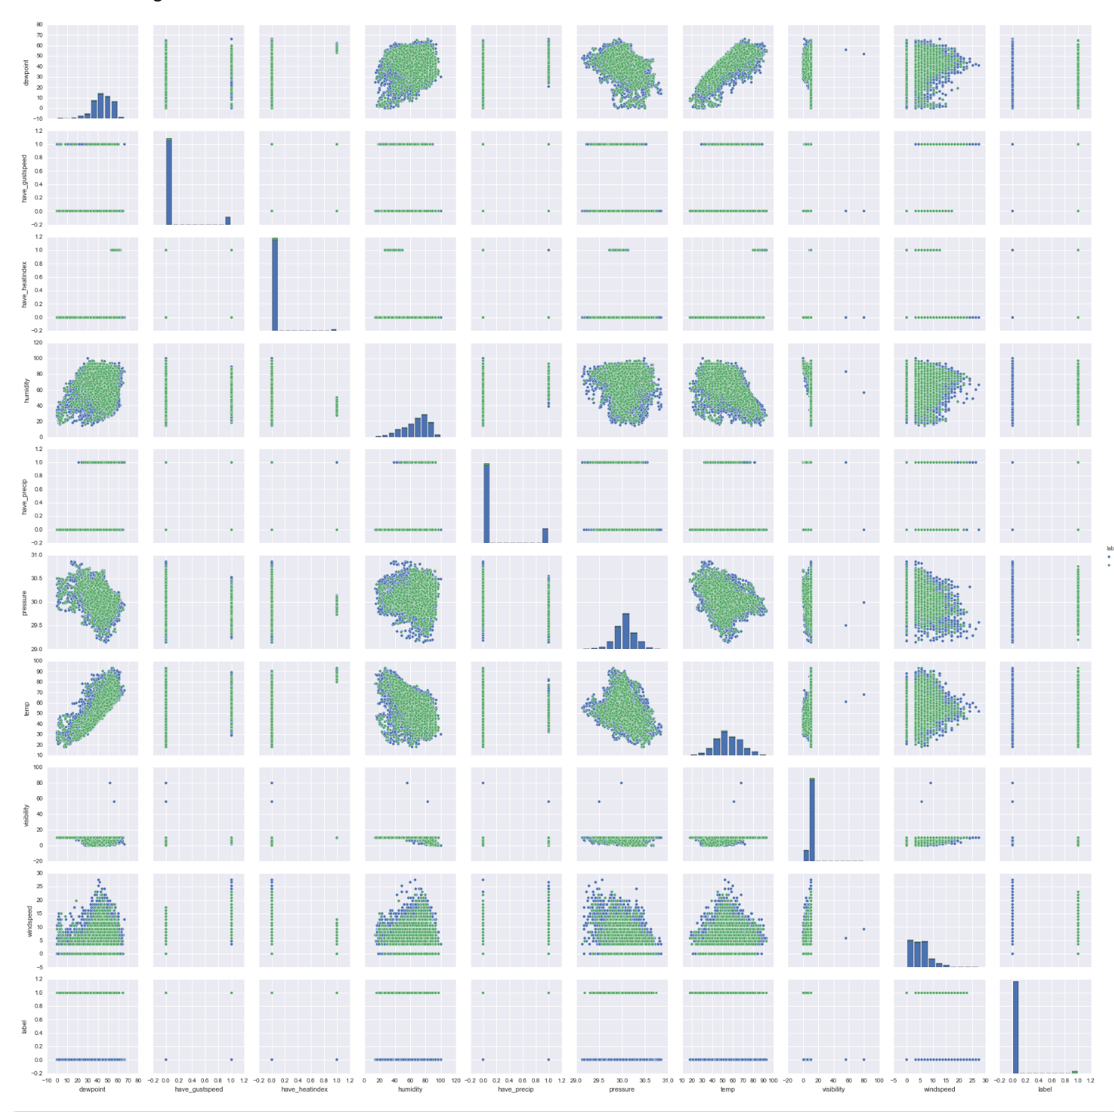
Key Insights

Slide 7
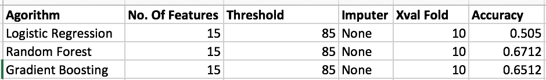

Model Summary
The log for the best model in each machine learning algorithms
Using the GRID SEARCH for optimizing the hyperparameter of a Random Forest

Slide 8
Visualizing Project Summary - Boston
Cambridge Government Data
Exploratory Data Analysis (Using Tableau)
Scrape Module
Model Bulding and Summary (Using R)

Slide 9
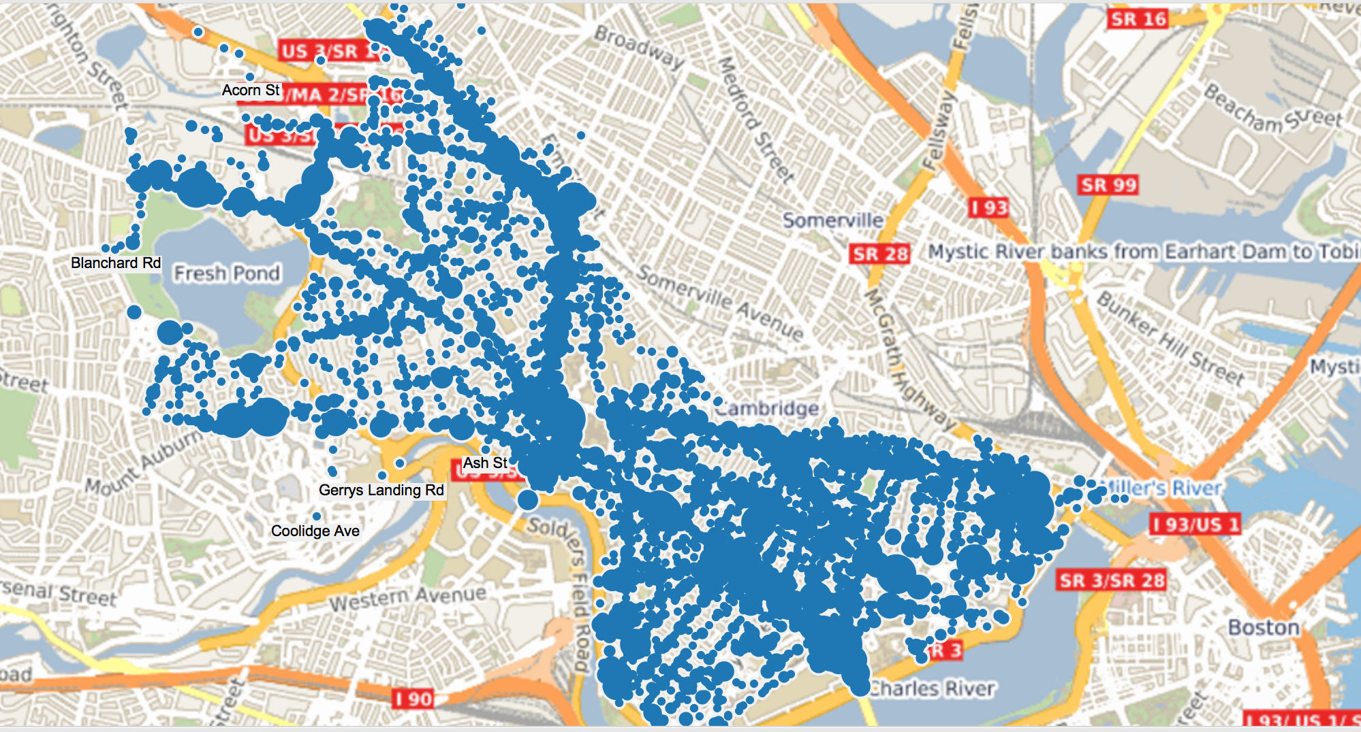
Distribution Of Accidents Based On Location

Slide 10
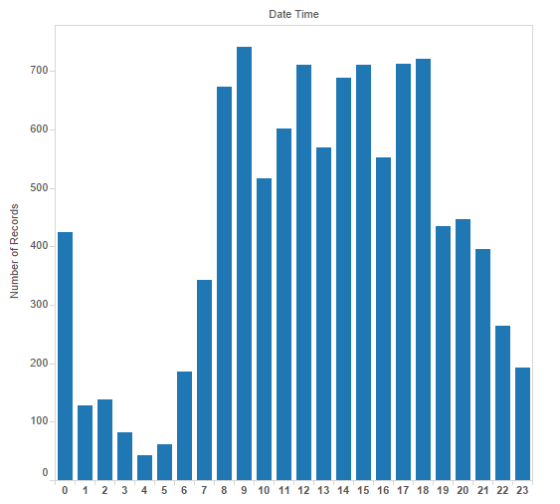
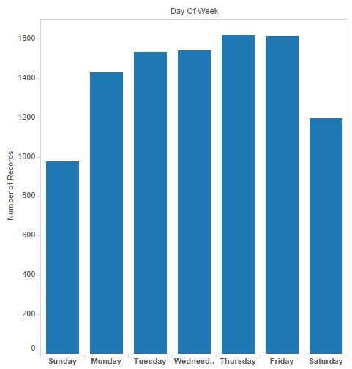
Distribution Of Accidents Based on Time

Slide 11
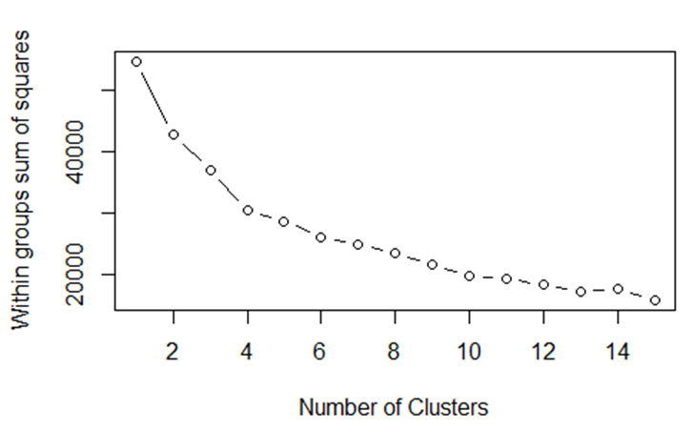
Model Summary

Slide 12
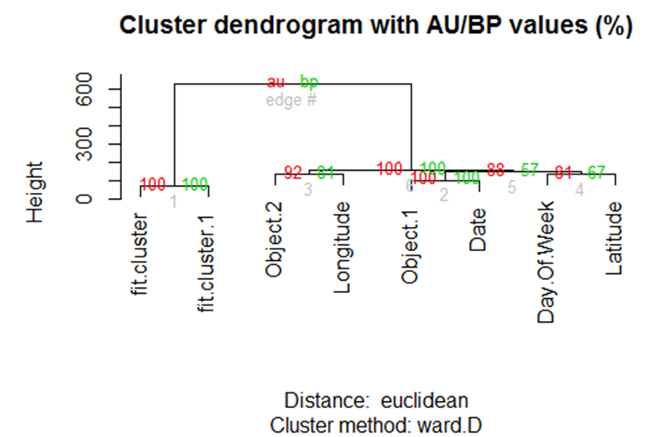
Hierarchical Clustering Dendogram Plot

Slide 13
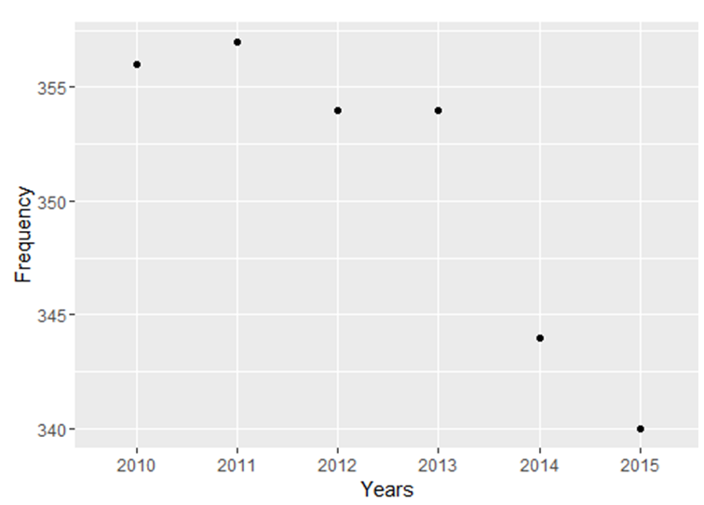
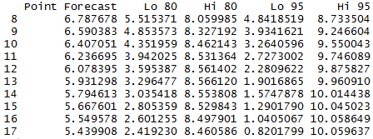
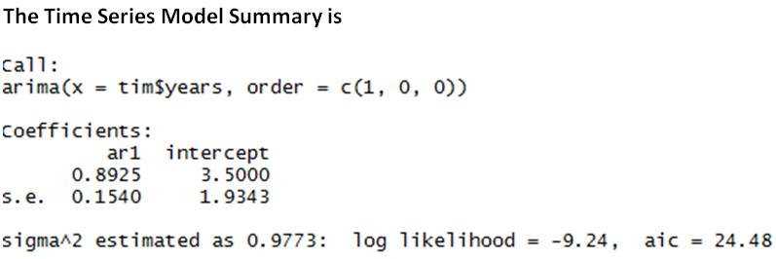
Time Series Forecasting

Slide 14
Future Scope
Build a live app for predicting the likelihood of road accident based on live data
Find ways to account for randomness

Slide 15
About My Research Project
Combining The Climate, 911 Response Data, Insurance Data to predict the safe pathway and reduce insurance premium if the customers follows the suggested safe path

Slide 16

Thank You
Venkatesh Subramaniam :
venkatesh.ase@gmail.com

